Slide 1




Social Buzz Data Visualization

Slide 2
Project Summary
Social Buzz is a fast-growing social media unicorn that needs to scale rapidly. Accenture has begun a three – month initial engagement to:
Audit their big data practice.
Provide Recommendations for a Successful IPO.
Analyze of their content categories that highlights the top 5 categories with the largest aggregate popularity.

Slide 3

Problem Statement
Users post over 100,000 pieces of content every day
With tens of millions of posts and hundreds of millions of users, how do you monetize ?

Slide 4

Uncovering Insights

Slide 5
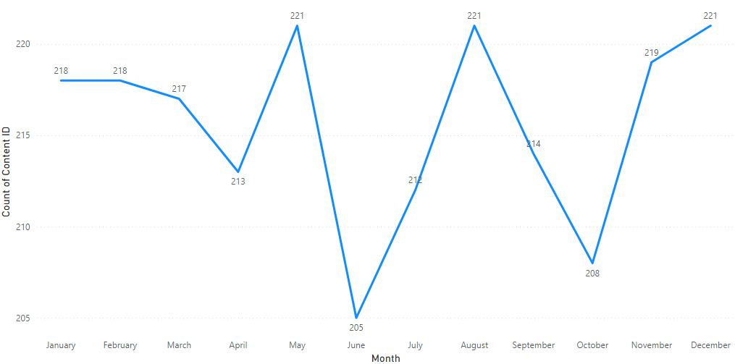
The number of posts shows noticeable fluctuations throughout the year. Peaks are observed in May and August, with notable drops in June and October. This could indicate specific events or seasonal trends that drive content creation during these periods.

Slide 6
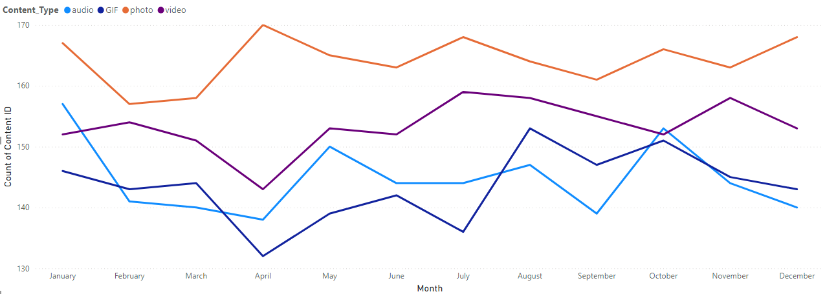
Photos are the most consistently popular content type, showing a steady presence across all months.
Videos also maintain a significant share but with some variability, showing dips in certain months.
GIFs and audio are less frequent and show more fluctuation, particularly with GIFs rising towards the end of the year. This suggests that visual content (photos and videos) dominates the platform, with possible spikes in GIFs during certain seasons.

Slide 7
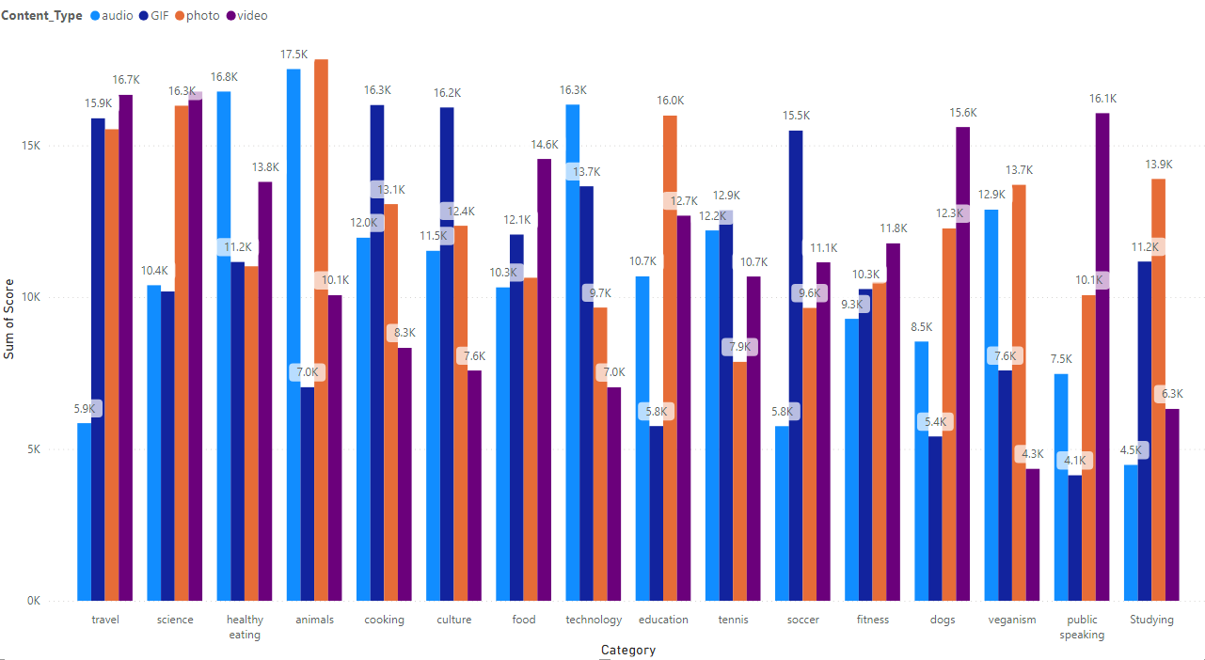
Categories like healthy eating, science, and studying score consistently high across all content types, particularly in video format.
Cooking and travel also perform well, with scores peaking in video format but showing strong performance in photos too.
This indicates that educational and lifestyle content tends to be well-received, especially in engaging formats like video.

Slide 8
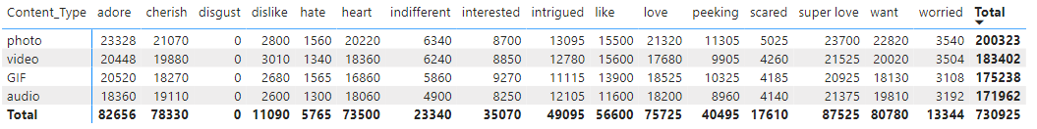
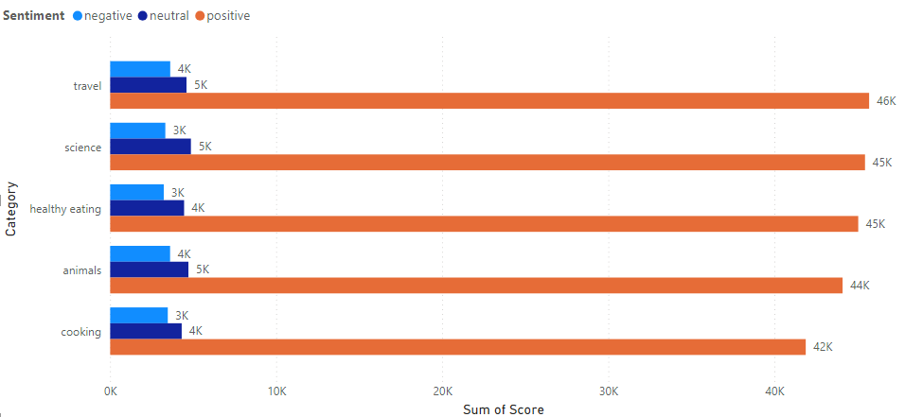
Photos and GIFs are the most engaging content types across a variety of reactions, including positive emotions like "love“, "heart" and "adore."
Videos follow closely but show higher levels of diverse reactions including "like" and "interested."
Audio is the least engaging, indicating it might be less effective in evoking strong reactions compared to visual content.
The dominant sentiment across all top categories is positive, followed by neutral and a relatively low presence of negative sentiment.
Categories like travel, science, and healthy eating generate the highest positive sentiment scores, suggesting these topics are perceived very favorably by the audience.

Slide 9
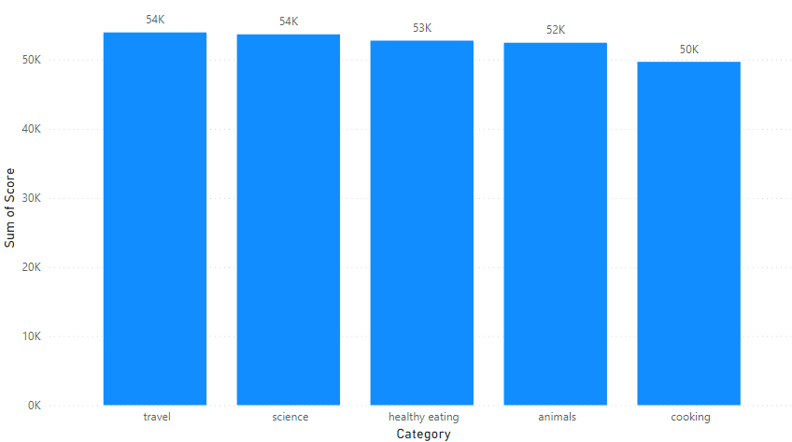
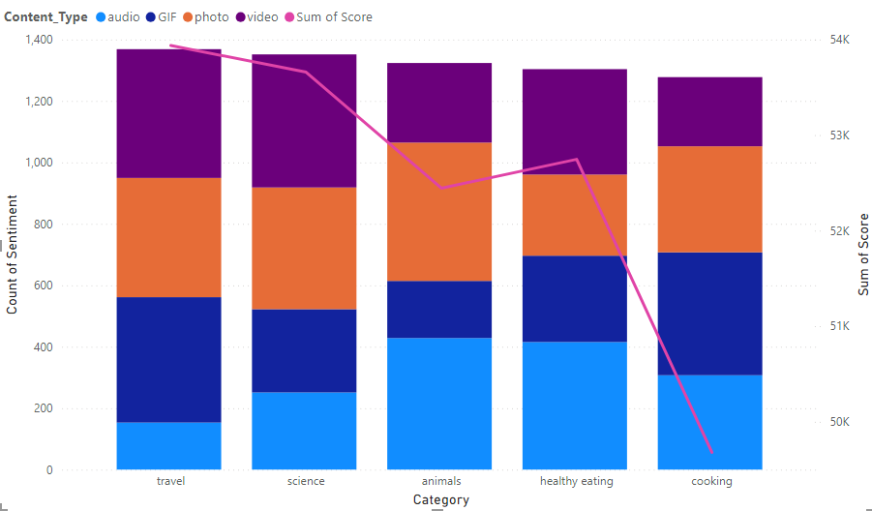
Travel and science are the top categories, both scoring over 50,000.
Healthy eating and animals also score well, indicating these are popular and engaging topics.
Cooking rounds out the top five, suggesting that content related to food and lifestyle continues to resonate with the audience.
Content Preference: Photos are the most popular content type across categories, while videos are more prevalent in certain niches like animals and healthy eating.
Sentiment Trends: Sentiment scores generally increase from travel to cooking, suggesting a potential correlation between content category and audience sentiment.

Slide 10
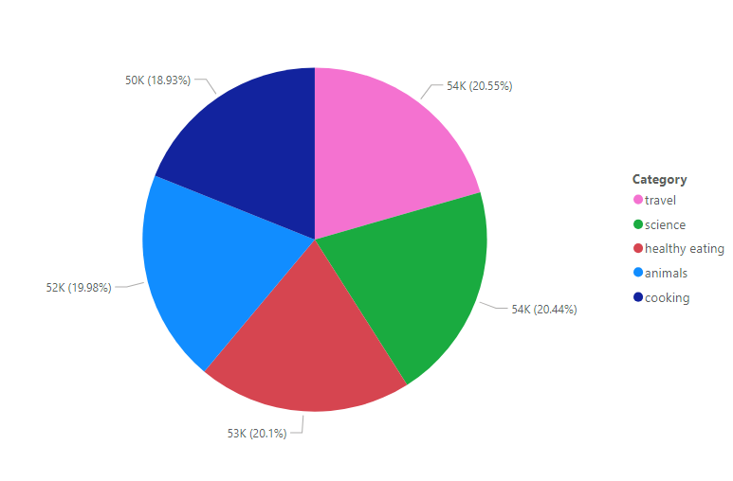
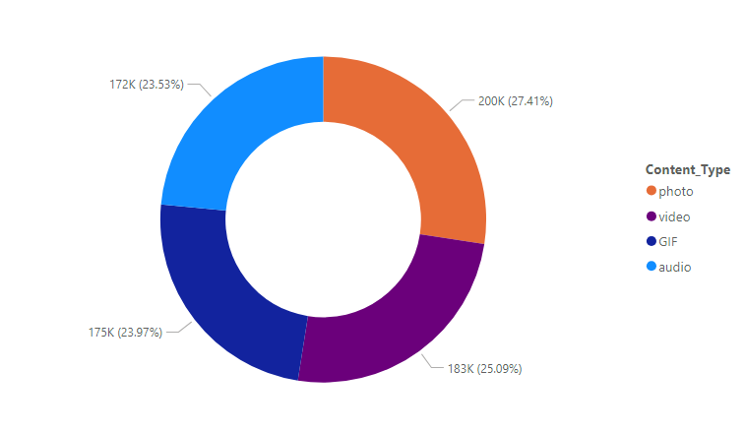
Even Distribution: Participant categories are evenly distributed, suggesting a diverse sample population.
Top Categories: Travel and Science are the most represented categories, indicating potential areas of interest for further analysis.
Content Type Balance: Content types are evenly distributed, indicating a variety of content formats.
Photo Dominance: Photos are the most popular content type, suggesting a strong preference for visual content.

Slide 11
Thank You

